Slide 1
TaxSlayer® Pro Online Practice Lab
An Introduction
Notes:
This lesson is intended to provide the tax preparer with an overview of the TaxSlayer practice lab software. Please review the notes section of the slides carefully for information about which lesson will contain detailed information regarding completing various input screens.

Slide 2
TaxSlayer Pro Online Practice Lab Software
Most internet browsers work:
  Internet Explorer 8.0 or higher
  Google Chrome
  Safari Browser 5.1.
For Practice Lab (either):
  https://vita.taxslayerpro.com/IRSTraining
  https://www.linklearncertification.com
Notes:
When you first enter the url, it will show as expanded as follows: https://vita.Taxslayerpro.com/IRSTraining/en/account/access.
TaxSlayer does not recommend using Firefox due to its weak firewalls that can be easily compromised.
However, we have received reports that Firefox works as well as Edge, the browser for Windows 10.
We may want to recommend linklearncertification.com so we just have one site to remember, especially when it comes to taking the test.
Firefox really does very well.

Slide 3
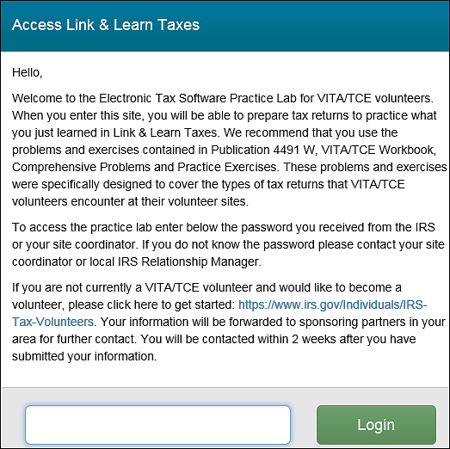
Log in - First Time
Enter Universal password: TRAINPROWEB
Notes:
Process for logging into production is different and is explained in the video in section 1 - Pro Online Login and password. All videos cover TaxSlayer production not Practice Lab – there are a few differences.

Slide 4
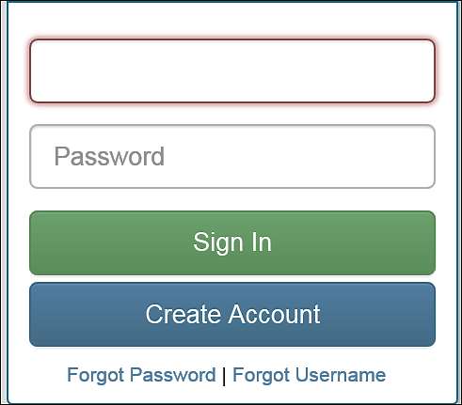
Log in – First Time (Continued)

Slide 5
Log in – First Time (Continued)
Enter e-mail address twice
Create a user name – include Train or Practice or PL
Create a password – alphanumeric with at least 6 characters (use only letters and numbers)
Enter password twice

Slide 6
Log in – First Time (Continued)
Select “AARP Tax-Aide” from “Program Type” drop down window
Enter SIDN (if known – not required)
Select security question
Enter answer to security question

Slide 7
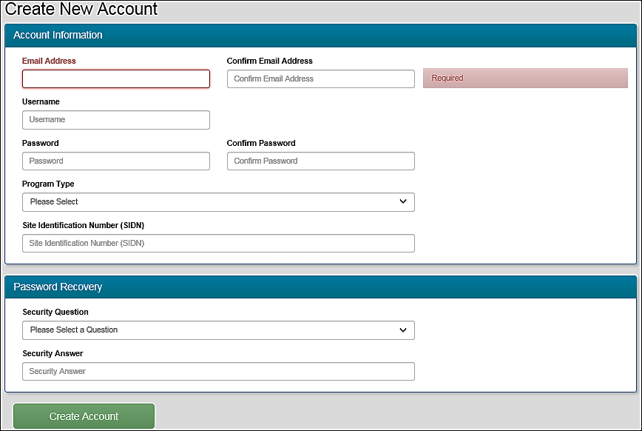
Log in - First Time (Continued)
Notes:
E-mail Address: Practice Lab displays a warning if you have previously used an email address in the Practice Lab system.
User Name: Use either Train or Practice in the user name. All user names in TaxSlayer Pro Online must be unique in all online platforms so User Name for Practice Lab cannot be used for Production. Practice Lab displays a warning if the user name has been created by another volunteer.
Password: Must be alphanumeric containing at least 6 characters. Is case-sensitive. For the production software, the password must be at least 8 characters long and must contain alpha, numeric and at least one special character. These requirements are based on the trusted customer requirements issued by the IRS security summit.
Program Type: Select AARP Tax-Aide from the drop-down list.
Site Identification Number (SIDN): Type in SIDN if you know it – not required
Security Question: Select a security question n from the list.
Security Answer: Type the answer to your security question.
Click Create Account

Slide 8
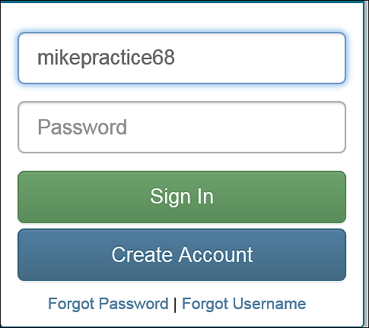
Log in – First Time (Continued)
First time you log in your user name will be shown
Enter password you just created and click on Sign in
Notes:
Refer to using the Practice Lab manual available on OSHC (Tax Training then TaxSlayer then select Practice Lab Intro and using the Practice Lab)
Next: how to set up a number of users for classes and labs.

Slide 9
Creating Accounts for Classes/ Labs
Instructor creates account for each student using:
  Student’s email address
  User name in standard format of 1st initial + last name + PL + group Identifier (e.g., site name)
  Password that is same for all students
  Security question/answer that is same for all students
Notes:
Assumes that students have not previously created an account in Practice Lab. This slide is designed for the instructor workshops to help instructors set up the class. When instructors are using these slides to train counselors, this slide should be hidden.
OK for workshop but not for training Counselors. Just hide slide.

Slide 10
Creating Accounts for classes/Labs – Students with account
Three Options:
  Student supplies username and password to instructor or,
  Same as above but student changes password to instructor supplied password by using Forgot password link or,
  New account created for student using dummy email.
Notes:
Refer to Practice Lab accounts for training doc also available on OSHC in TaxSlayer folder.
Dummy e-mail may not be a good idea. It could be live!

Slide 11
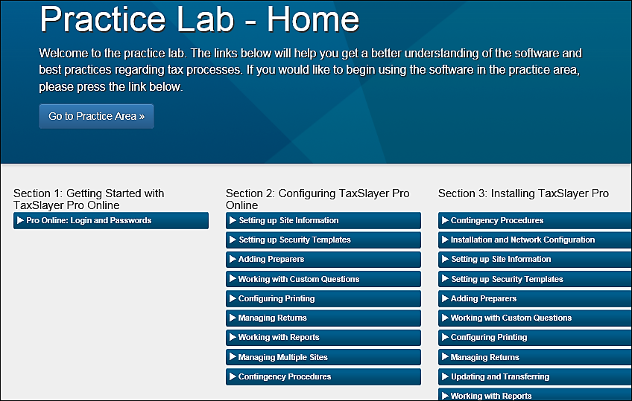
Practice Lab – Home Page
Takes you to practice area
Select a training video
Notes:
Note: Section 1: Getting started with TaxSlayer Pro Online. The Pro Online Login and Passwords video provides you with information about how to long into the production version of TaxSlayer Pro, not the practice lab. To access a video that covers logging into the PL use the url (http://bit.ly/1ZcELb1) found at the bottom of the TaxSlayer Practice Lab Intro document on OSHC. Section 2 contains video that will be used by the LC in setting up the site. Section 3 contains videos for the desktop version of TaxSlayer. We will NOT be using desktop as a contingency.

Slide 12
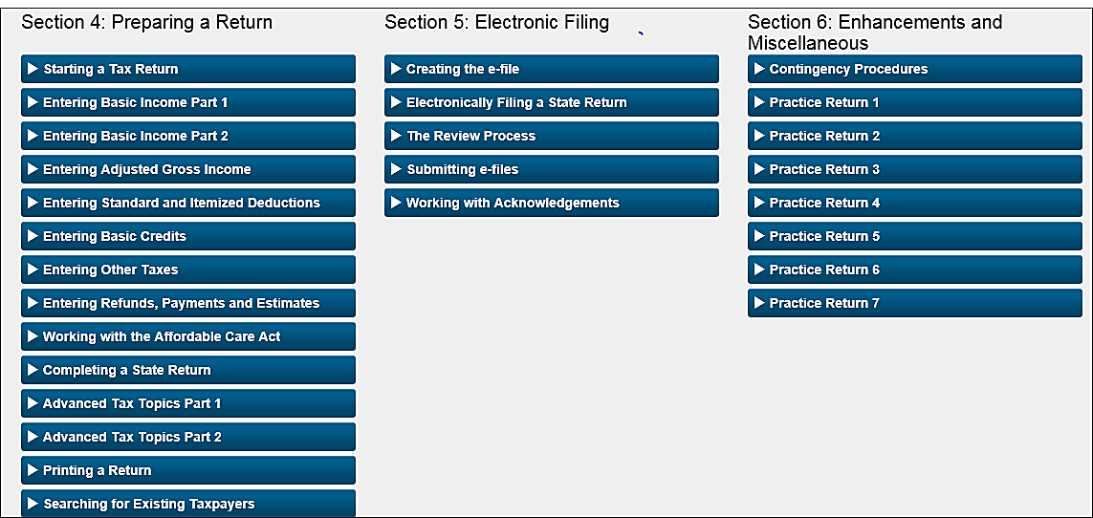
Practice Lab – Home Page (Continued)
Notes:
Section 4 contains videos that cover how to prepare a return and are helpful. Be careful when using the videos as they do contain information that does not match with the current practice lab. For example, the Creating the e-file video found in Section 5 contains information about form 8888 which has not been activated in the practice lab. Section 5 covers e-filing and some can be used for PL. Since you cannot submit an e-file in PL, the last 2 videos in this section do not apply to PL. Section 6 contains practice returns.

Slide 13
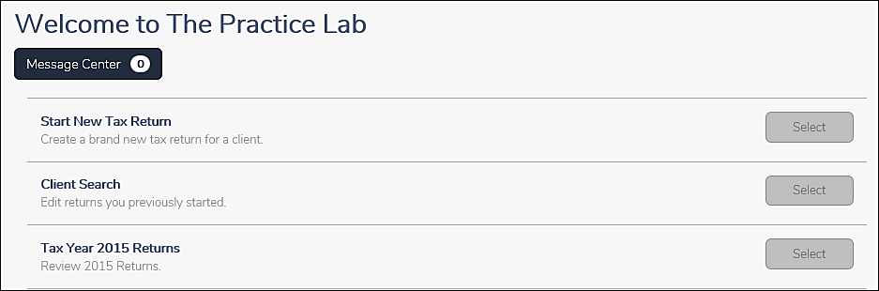
Practice Lab – Welcome Page
Notes:
You will arrive at this welcome page if you select “Go to Practice Area” instead of selecting a video
Message Center feature is designed to help the site or local coordinator pass on information to preparers at the site. Also used by TaxSlayer to provide information regarding changes to the software. It is NOT to be used to submit questions to TaxSlayer.
To start a new 2016 return select, “Start New Tax Return”.
To review a 2016 return already created select, “Client Search”.
To start a new 2015 return or review a 2015 return already created, select “Tax Year 2015 Returns”.

Slide 14
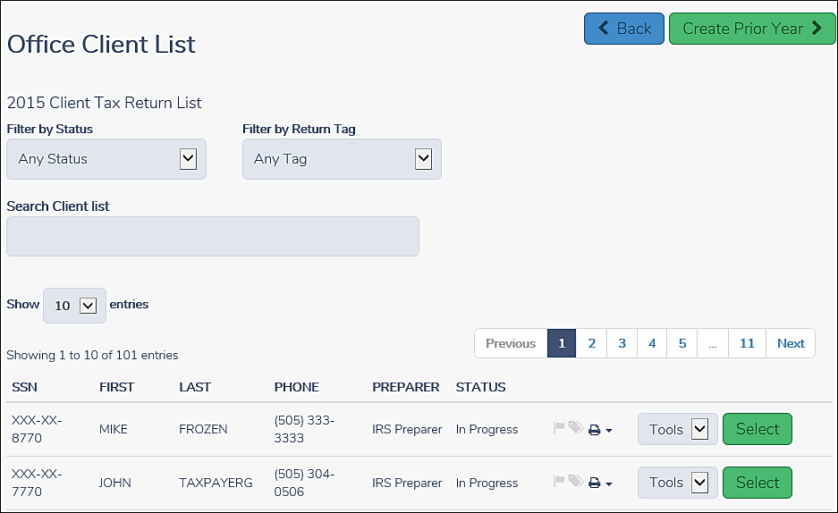
Practice Lab – 2015 Returns
Notes:
To start a new 2015 return select, “Create Prior Year.
To review a return already created, select the return from the list.
Until each state approves the TaxSlayer software, you MUST use 2015 to create a state return.

Slide 15
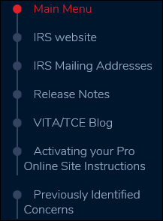
Practice Lab Helpful Information Page
Notes:
Provides link to VITA/TCE Blog. Can also use TaxSlayer Springboard at: https://vita.taxslayerpro.com/ to access VITA/TCE BLOG, practice lab and production site.
Activating your Pro Online Site Instructions takes you to VITA/TCE Blog entry re site activation instructions. Designed for DC’s and LC’s to help with site activation.

Slide 16
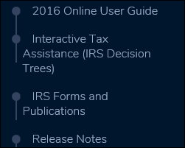
Practice Lab Helpful Information Page (Continued)

Slide 17
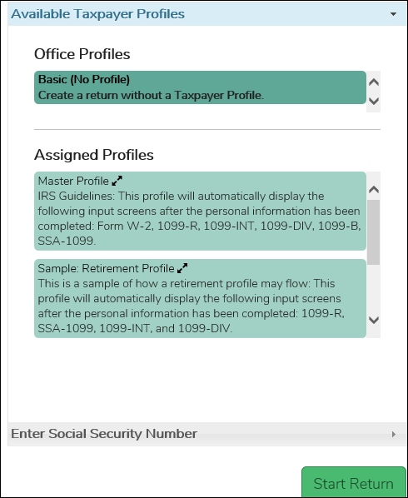
Available Taxpayer Profiles
TaxSlayer has created 3 sample profiles. Defaults to Basic (No profile).
Site/Local Coordinator can create additional Taxpayer profiles when setting up site
Notes:
Profiles are now above the Enter Social Security Number field.
No limit on number of profiles that can be created. Practice lab now contains 3 additional profiles not shown above. A Retirement profile which contains a 1099-R, SSA-1099, 1099-Int, and a 1099-Div. A Itemized deductions profile which contains a W-2, 1099 – Int and Schedule A input screens. A Business Income profile which contains a 1099-Misc which will give you the option of adding a new Schedule C. In the production version, the site/local coordinator is responsible for creating Taxpayer profiles.

Slide 18
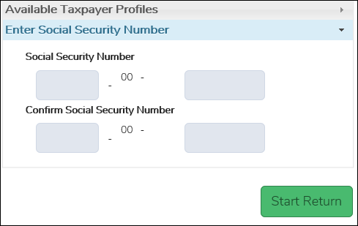
Start New Tax Return Screen
00
00
Notes:
TaxSlayer has prefilled the 4th and 5th number of SSN.

Slide 19
Navigation/Input Rules
All information is entered via input screen (nothing entered directly on forms)
Use “Tab” key to move from field to field within input screen
Select “Continue” to save information and move from one input screen to another
Notes:
If you enter information and do not click on continue you will get a warning at the top of the page.

Slide 20
Navigation/Input Rules (Cont)
Do not enter leading zeros when entering dates of birth:
Six methods of inputting data:
  Guide me
  Enter myself
  1040 View on Calculation Summary page
  Taxpayer Profile
  Quick File
  Form Search Box
Notes:
If you are opening an existing return, the software will automatically take you to the 1040 view page. Age will be shown in production. Exact location TBD.

Slide 21
Navigation
Filing Status is 1st screen you must complete after entering SSN
Filing Status Wizard available
Personal Information screen must then be completed
Dependent screen next (one screen for each dependent)
Notes:
Regardless of which input method you choose you must complete filing status screen first.

Slide 22
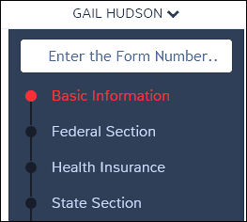
Left navigation bar
Will take you to input screen for form
Section you are in will be red
Input screens for all forms except Health Insurance
Health Insurance input screens
Create state return
Notes:
Once you enter social for new return or select existing return, the screen will contain a new navigation bar.

Slide 23
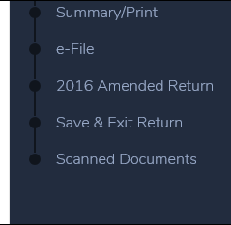
Left navigation bar (Continued)
1040 view, summary and print
Must complete health insurance and EITC to e-file
Amend 2016 return
Takes you to practice lab welcome screen
Cannot scan in practice lab. Will have scan capability in production

Slide 24
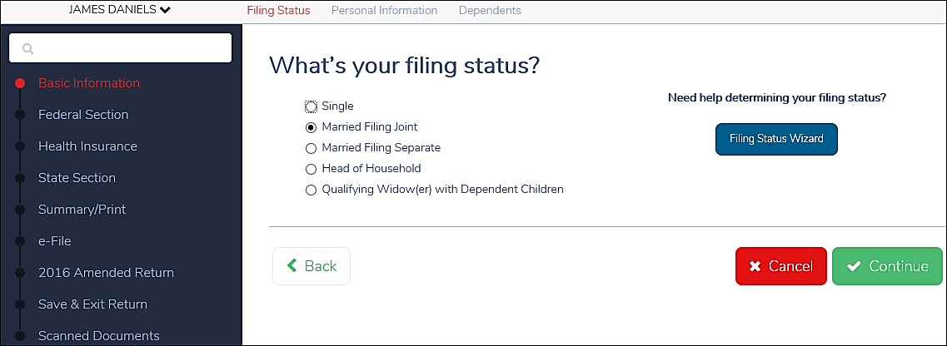
Filing Status Screen
Notes:
Screen you are currently in will be red. Other screens will remain blue.

Slide 25
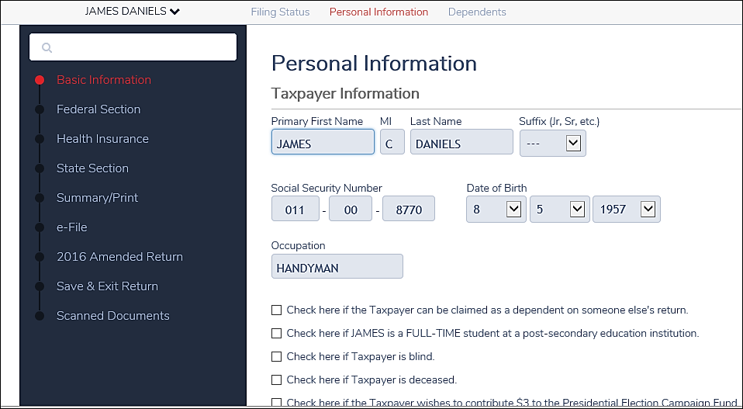
Personal Information Screen

Slide 26
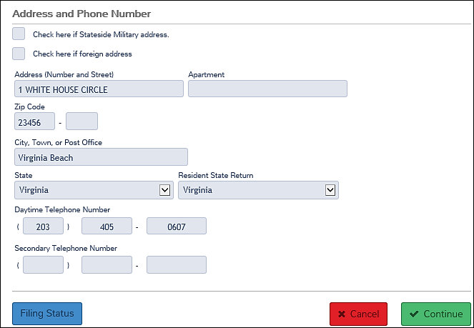
Personal Information Screen (Continued)

Slide 27
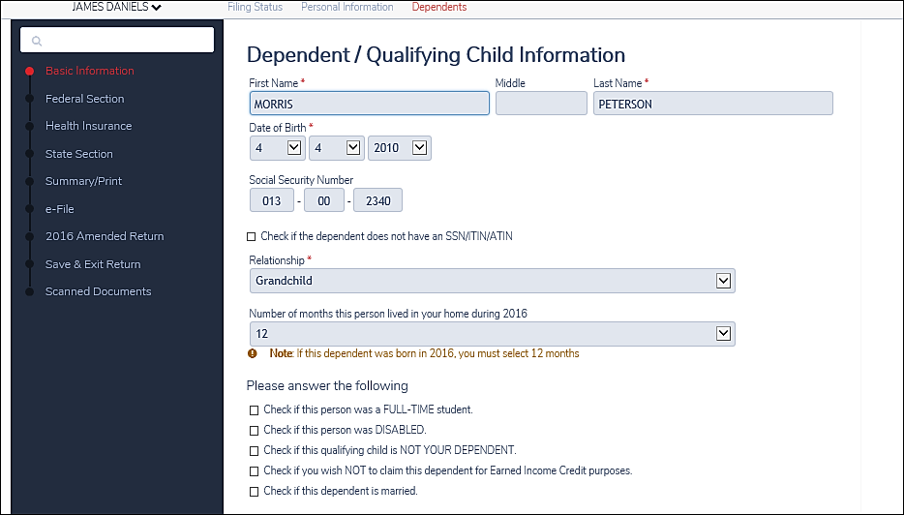
Dependent Information Screen
Notes:
Must use separate input screen for each dependent.

Slide 28
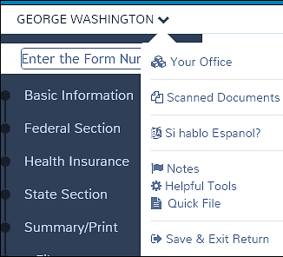
Additional Tools
Select drop down arrow next to name
Must complete filing status, personal and dependent information to activate tool bar

Slide 29
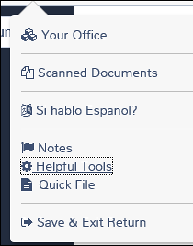
Additional Tools (Continued)
Logs you out to welcome page
Access denied at this time
Select Spanish
Add notes to return
Logs you out to welcome page
Notes:
Helpful tools and quick file on next slides.

Slide 30
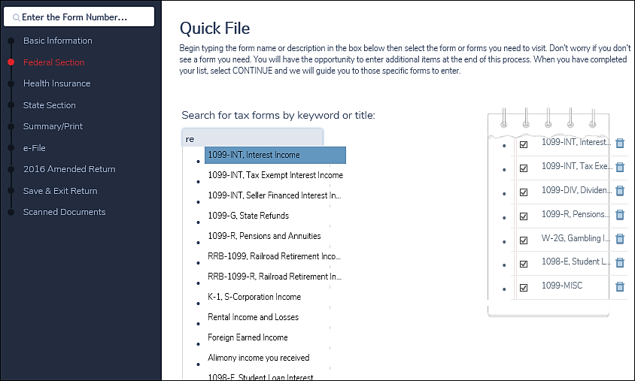
Quick File Tool
Notes:
Entering “re” in search box will provide you with a list of all forms that contain re. In this example 24 forms are listed.
Have selected and completed 7 forms using the quick file tool

Slide 31
1040 View
Select “Summary/Print” from left navigation bar for 1040 view screen.
Then select any line on 1040 to link to input screen for that line
Select green “Summary View” button for Summary Calculation Screen

Slide 32
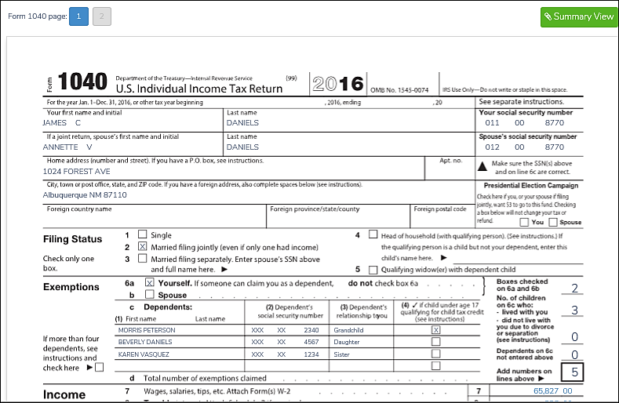
1040 View Screen
Notes:
Click one: Select line and you will be taken to input screen. For example, if you click on line 7, you will be taken to W-2 input screen. Eliminates several navigation steps. Can also be used to QR return to quickly move to input screen to input and/or verify amounts.
Click two: Select Summary view button to go to Calculation Summary Screen

Slide 33
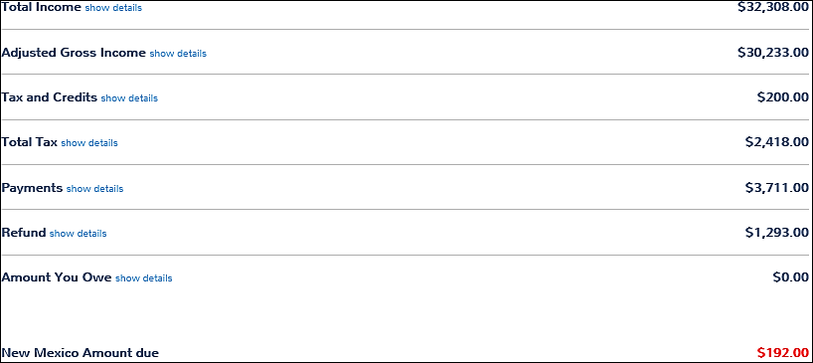
Calculation Summary Screen
Notes:
If you select “summary view” you would land at the calculation summary page where you can drill down to detailed amounts by selecting “show details”.

Slide 34
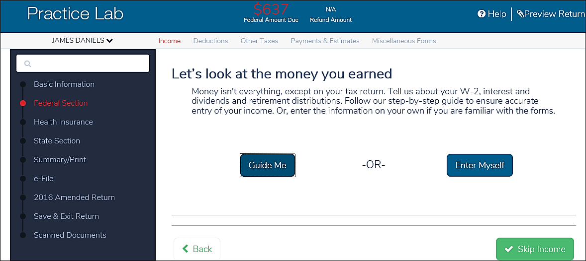
Income Screen
Notes:
If you selected “Assigned Profile”, or had created a quick file, you would skip this screen and go straight to the W-2 input screen. If you select “Summary Print” from the navigation bar you would skip this screen and go to 1040 view where you could select income and go straight to W-2 input screen.

Slide 35
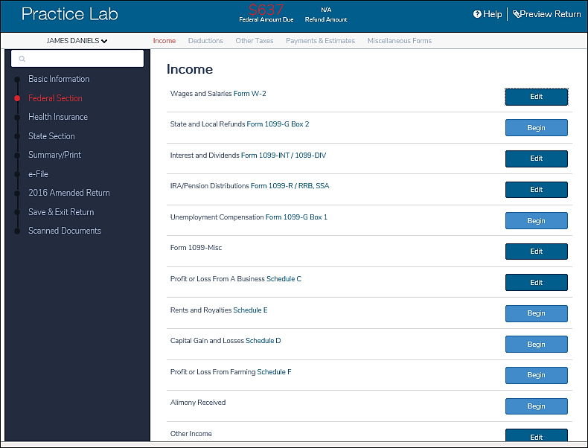
Income Screen
Edit allows you to change data .
Begin allows you to input new data.
Notes:
Edit (dark blue) to change original input data. Again, if you are using a Taxpayer Profile, have created a quick file list or use the summary print you will skip this screen. NOTE: Every item on this screen except Schedule D and other income can be included in Quick file.
Highlight and explain EDIT versus BEGIN.
How to complete the input screens for the various income items listed on the income screen will be covered in other lessons. For example, inputting W-2 income will be covered in lesson 12, “Income Wages”, while interest and dividend income will be covered in lesson 13, “Income Interest and Dividends”.

Slide 36
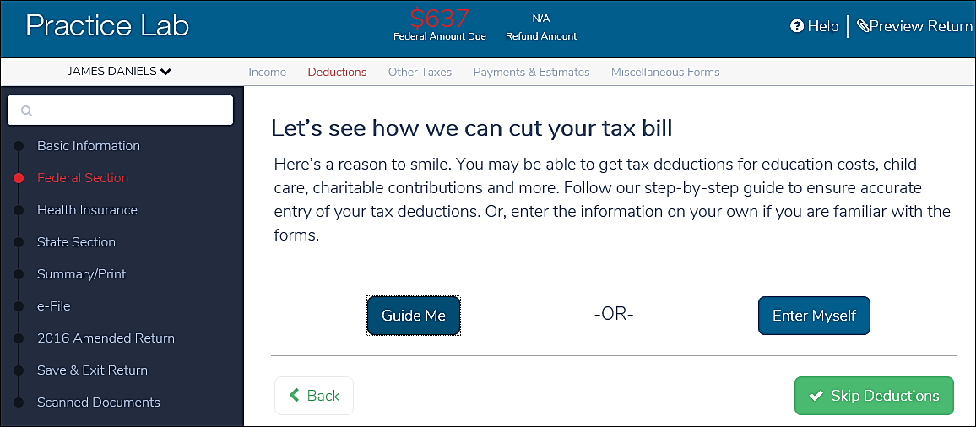
Deduction Screen

Slide 37
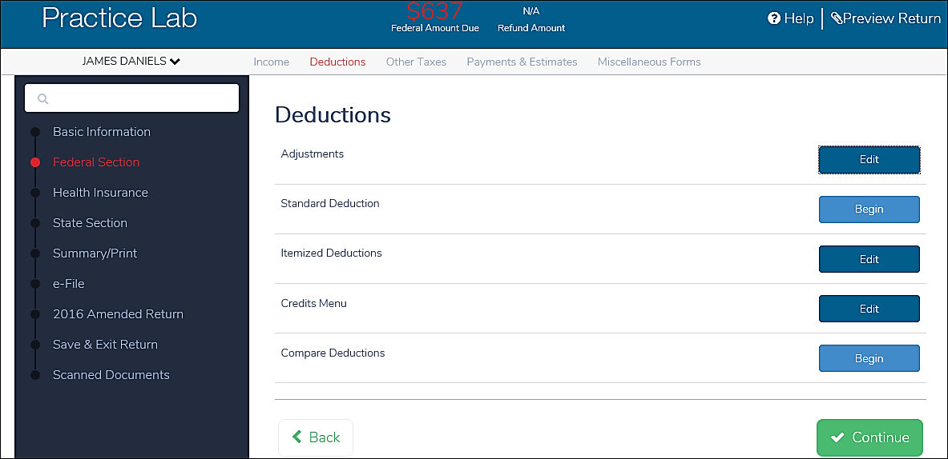
Deduction Screen (Continued)
Notes:
Remember, in TaxSlayer, deductions includes:
Click one, adjustments,
Click two, itemized deductions,
Click three, credits.

Slide 38
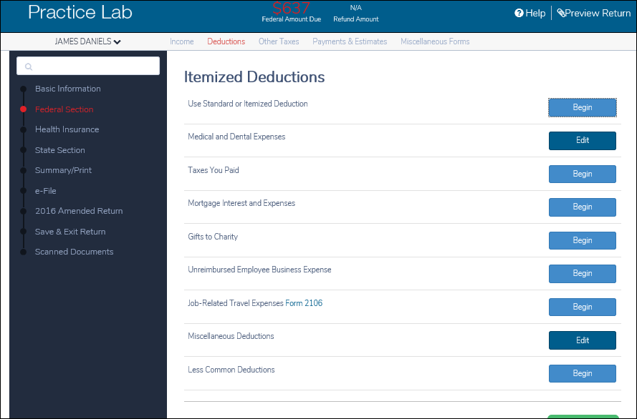
Itemized Deductions Screen
Notes:
Can list some itemized deductions in Quick File (e.g., medical, taxes, mortgage interest, gifts to charity, unreimbursed employee business expenses, and job-related travel expenses) cannot include misc deductions and less common deductions (e.g., business use of home and investment expense).
Lesson # 26 will cover how to enter all of the possible itemized deductions.

Slide 39
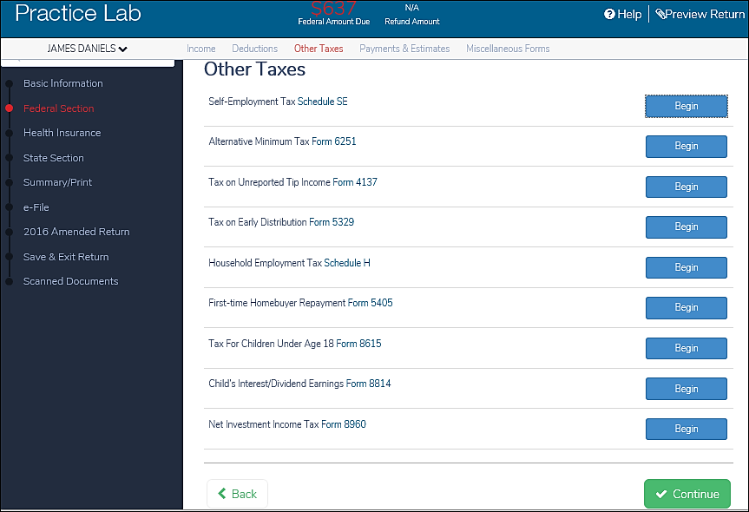
Other Taxes
Notes:
Only item on this list that is included in Quick File is First-time Homebuyer repayment.

Slide 40
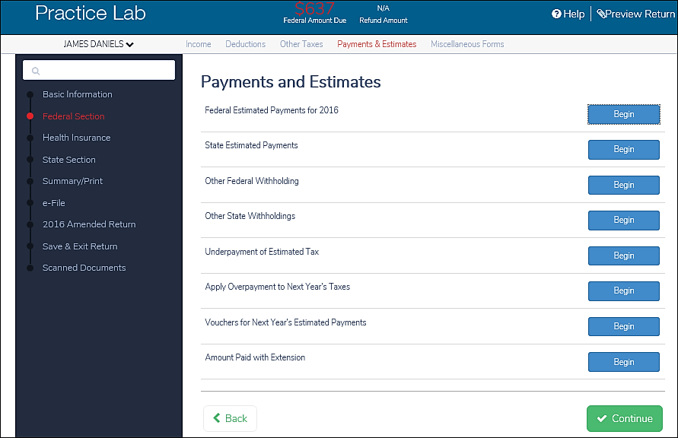
Payments and Estimates
Notes:
Federal and state estimated payments can be preloaded using Quick File.

Slide 41
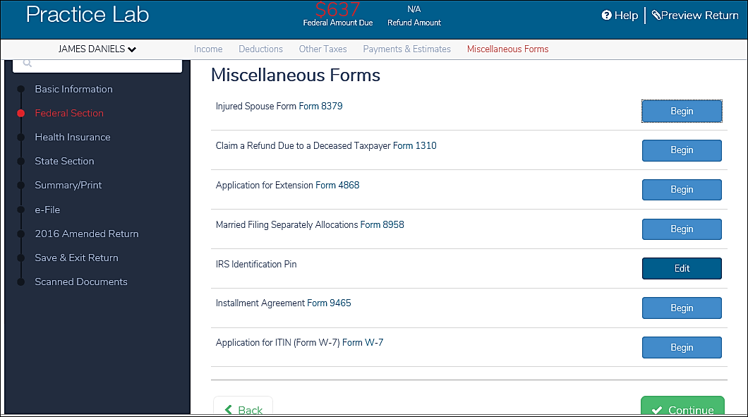
Miscellaneous Forms
Notes:
Quick File items: IRS IP and installment agreement.

Slide 42
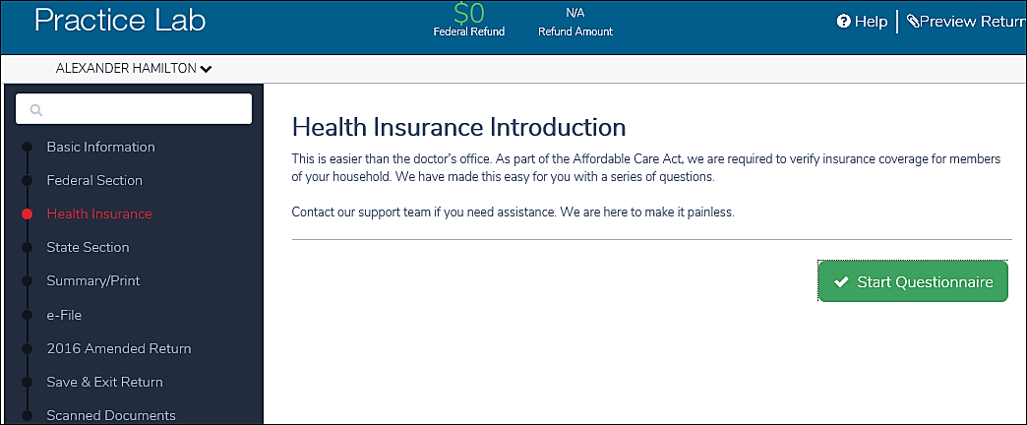
Health Insurance Introduction Page
Notes:
When entering data for a new client, this is the initial Health Insurance screen you will see.

Slide 43
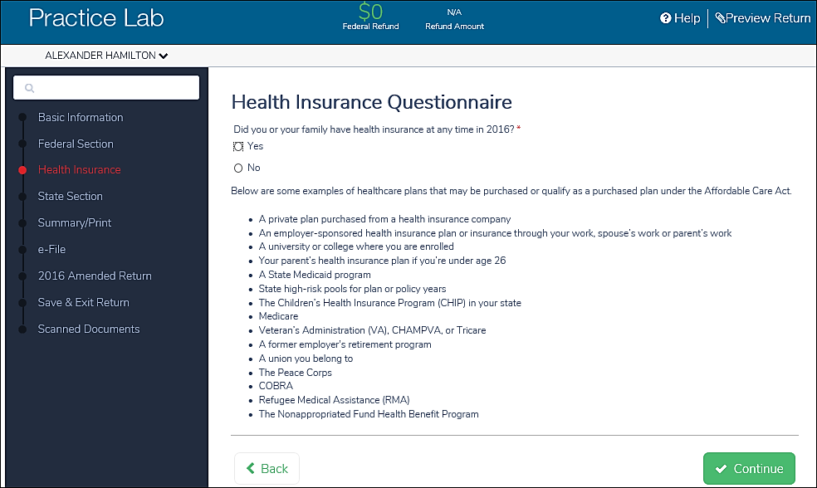
Health Insurance Questionnaire
Notes:
Completing the Health Insurance section will be covered in the Affordable Care Act lesson.

Slide 44
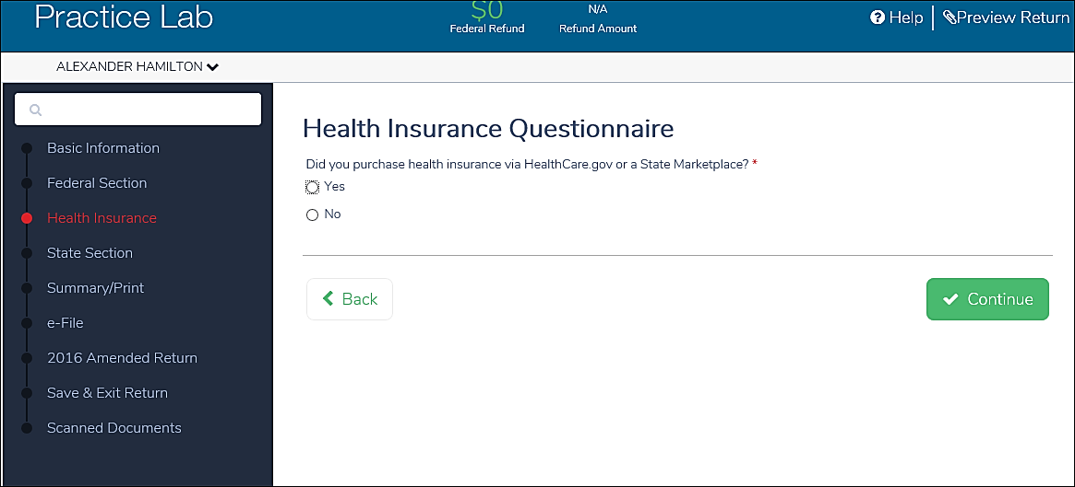
Health Insurance Questionnaire

Slide 45
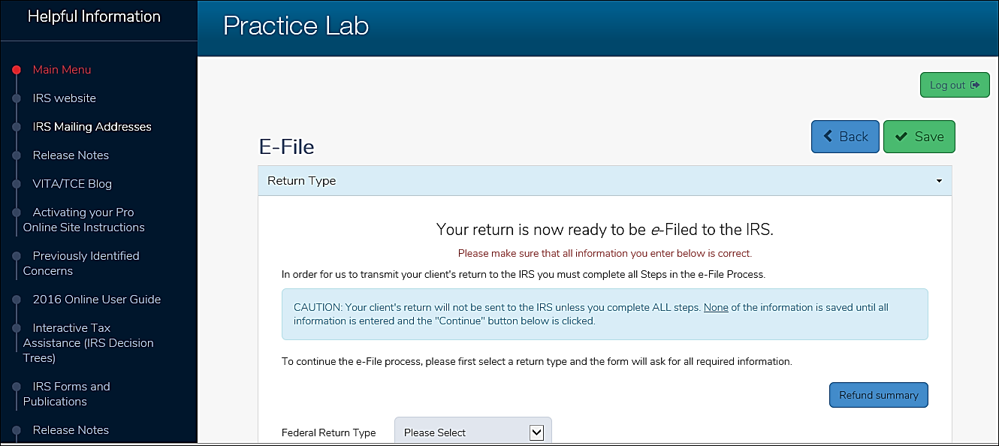
E-File Screen
Notes:
Once you have successfully completed all sections of the federal and state return, you will be taken to this E-File screen. How to complete the e-file section will be covered in a separate training lesson and in the ERO Transmitted Training lesson.

Slide 46
TaxSlayer/Training
Questions…
Comments…

